Slide 1

Artificial Intelligence in Healthcare
Project title: AI-Powered Clinical Decision Support System Using Reinforcement Learning
Tahmina Alam

Slide 2
Background
In real life, doctors use experience and clinical knowledge to make these decisions, but building an AI system that can assist with this process can improve efficiency and support decision-making.
Since real medical datasets are difficult to access due to privacy and ethical concerns, I used synthetic patient data to simulate real-world cases. This project focuses on using Reinforcement Learning (Q-learning) to recommend treatments, suggest doctor types, and generate explanations with audio support for better user interaction.

Slide 3
Goal
Build an AI system that:
generates patient cases
predicts disease from symptoms
selects the best treatment
suggests the correct doctor
explains the decision using LLM
provides audio explanation

Slide 4
Project Objective
Use Reinforcement Learning (Q-learning) to help simulate clinical decision-making.
Compare with:
Random policy
Rule-based policy
RL policy
Final Goal:
Check whether RL can learn treatment decisions close to expert rule-based logic.

Slide 5
Synthetic Patient Generation and RL Environment Design
Why Synthetic Data?
RL Environment Design
Real medical datasets are difficult to access.
What I generated
Age
Symptoms
Severity
Disease type
Environment = Clinical TrialEnv
State
(Disease, Severity Level)
Example:
(Covid, High)
Actions
Treatment A / B / C
Reward
Improved = +10
No Change = 0
Side Effect = -6

Slide 6
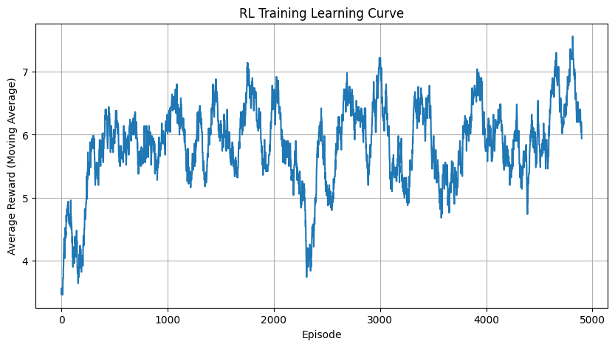
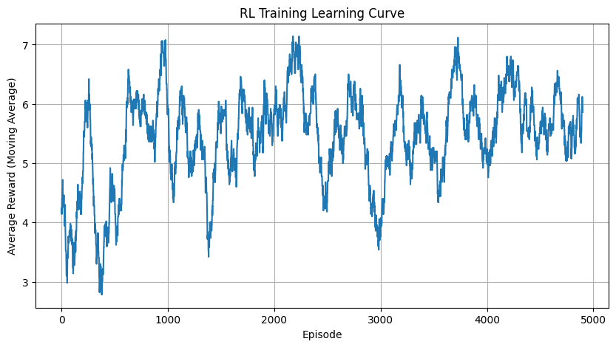
Q-Learning Curve

Slide 7
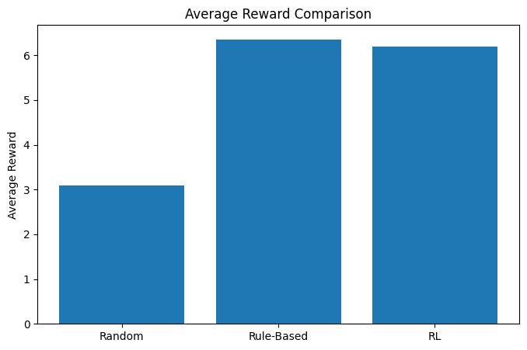
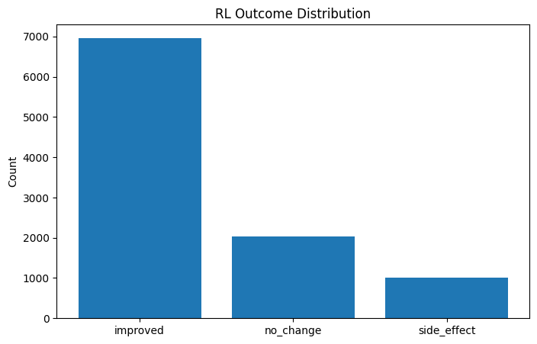
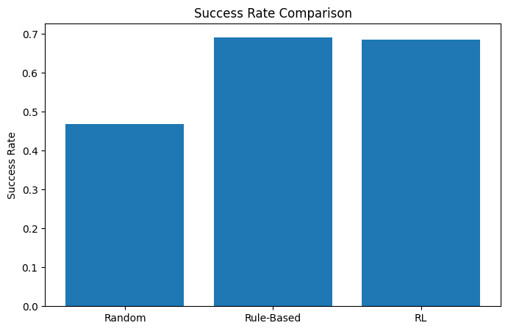
Policy Comparison Results
Results

Slide 8
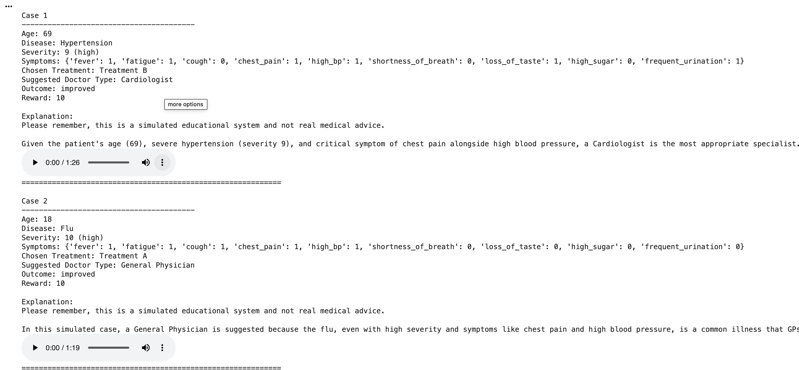

LLM Explanation + Audio Feature on Result

Slide 9
Difficulties Faced and Future Plan
Difficulties
Future plan
Real medical data was difficult to access
Creating realistic synthetic patients was challenging
RL training had fluctuations and debugging issues
Gemini API had quota and model errors
Audio integration required handling empty explanations
Use real hospital datasets
Add multi-step treatment decisions
Improve prediction with more ML models
Make the app more interactive

Slide 10
Conclusion
This project successfully built an AI-based clinical decision support system using Reinforcement Learning. The system generates synthetic patient cases, predicts disease, recommends treatment, and suggests the appropriate doctor. The RL model performed much better than random policy and close to the rule-based approach. Adding LLM explanations and audio support made the system more interactive and easier to understand. This project shows how AI can support smarter healthcare decision-making in a simulated environment.

Slide 11
Thank You
“Stay safe, stay healthy, and let AI help build a better healthcare future.”

